Slide 1
Discotective
Final presentation
19 april 2011
Katie Bouman • Brad Campbell • Mike Hand • Tyler Johnson • Joe Kurleto
Notes:
MIKE

Slide 2
Project Overview
Optical Music Recognition (OMR) system
Takes in image of sheet music
Finds and analyzes musical symbols
Outputs captured song as audio signal
Notes:
MIKE

Slide 3
Motivation
Music students
Learning to read sheet music is difficult
Knowing how the music should sound makes it easier
Digital archival
Longevity
Electronic availability & distribution
Possibility for editing
Notes:
MIKE

Slide 4
Music Recognition Systems
Current software
SmartScore (Musitek)
SharpEye (Musicwave)
Notescan – Nightingale
SightReader – Finale
Photoscore – Sibelius (Neuratron)
None are embedded
Use scanners for image acquisition
Notes:
MIKE

Slide 5
The Design
Preprocessing
Segmentation
Classification
Audio synthesis
Notes:
TYLER

Slide 6
The Design
Preprocessing
Segmentation
Classification
Audio synthesis
Notes:
TYLER

Slide 7
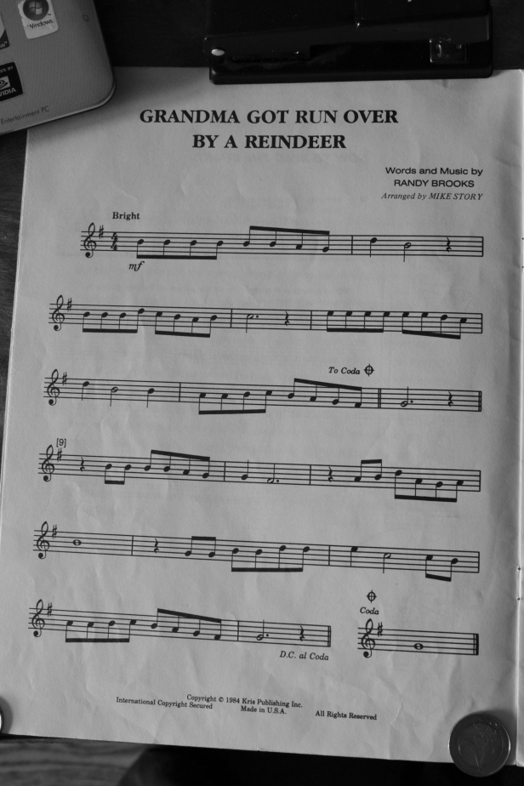

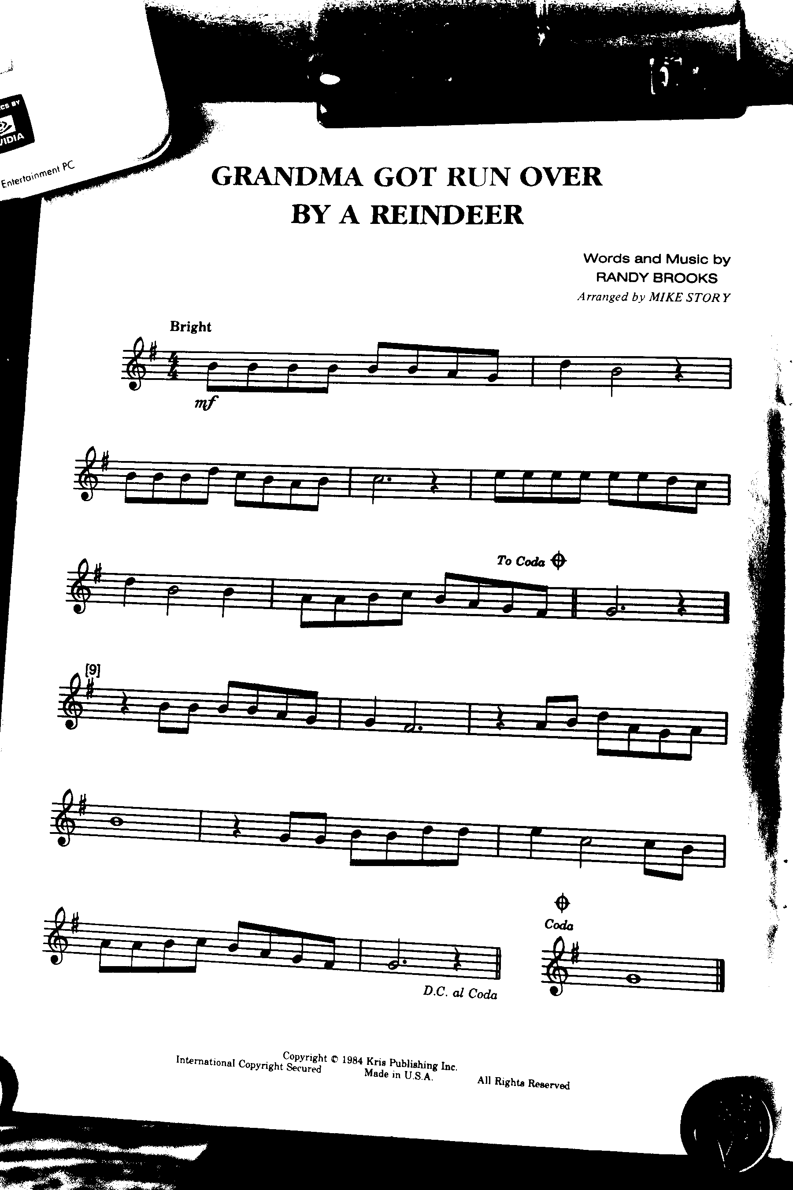
Preprocessing
Adaptive binarization
Original image
Adaptive threshold
Binarized image
Notes:
TYLER

Slide 8
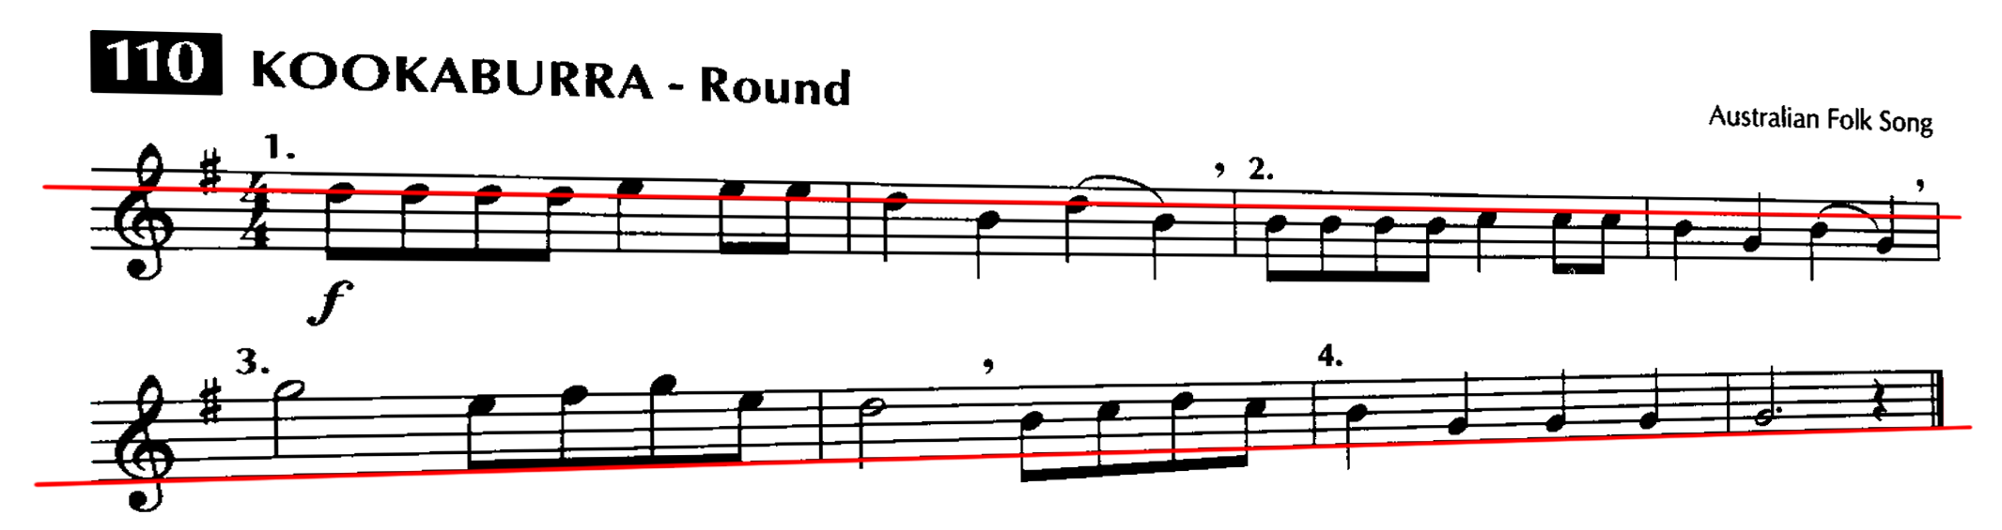
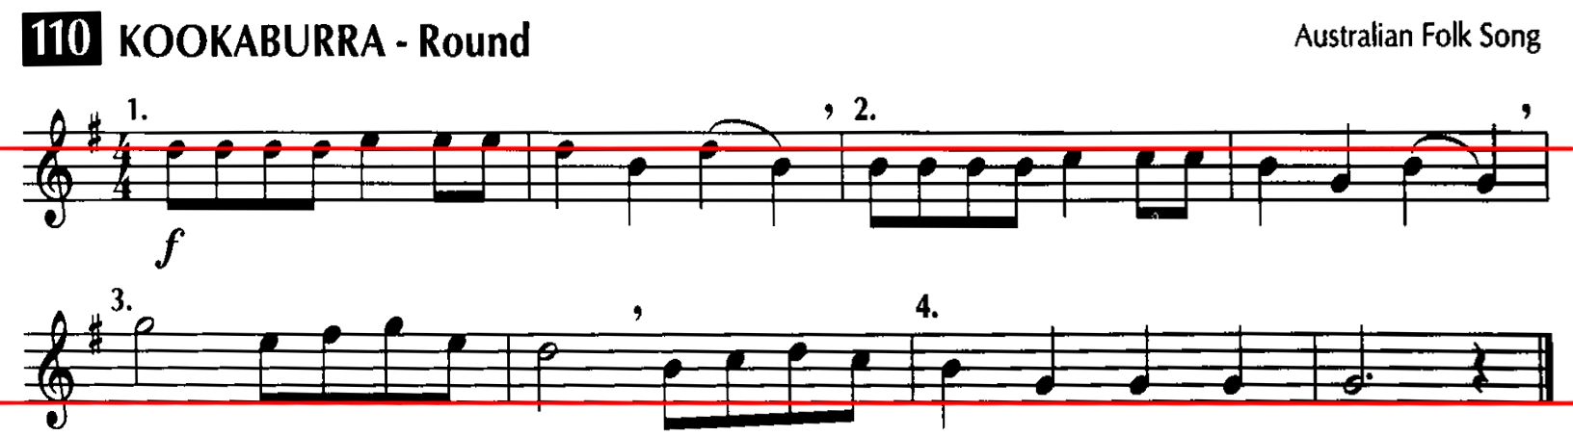
Preprocessing
Skew correction
Notes:
TYLER

Slide 9
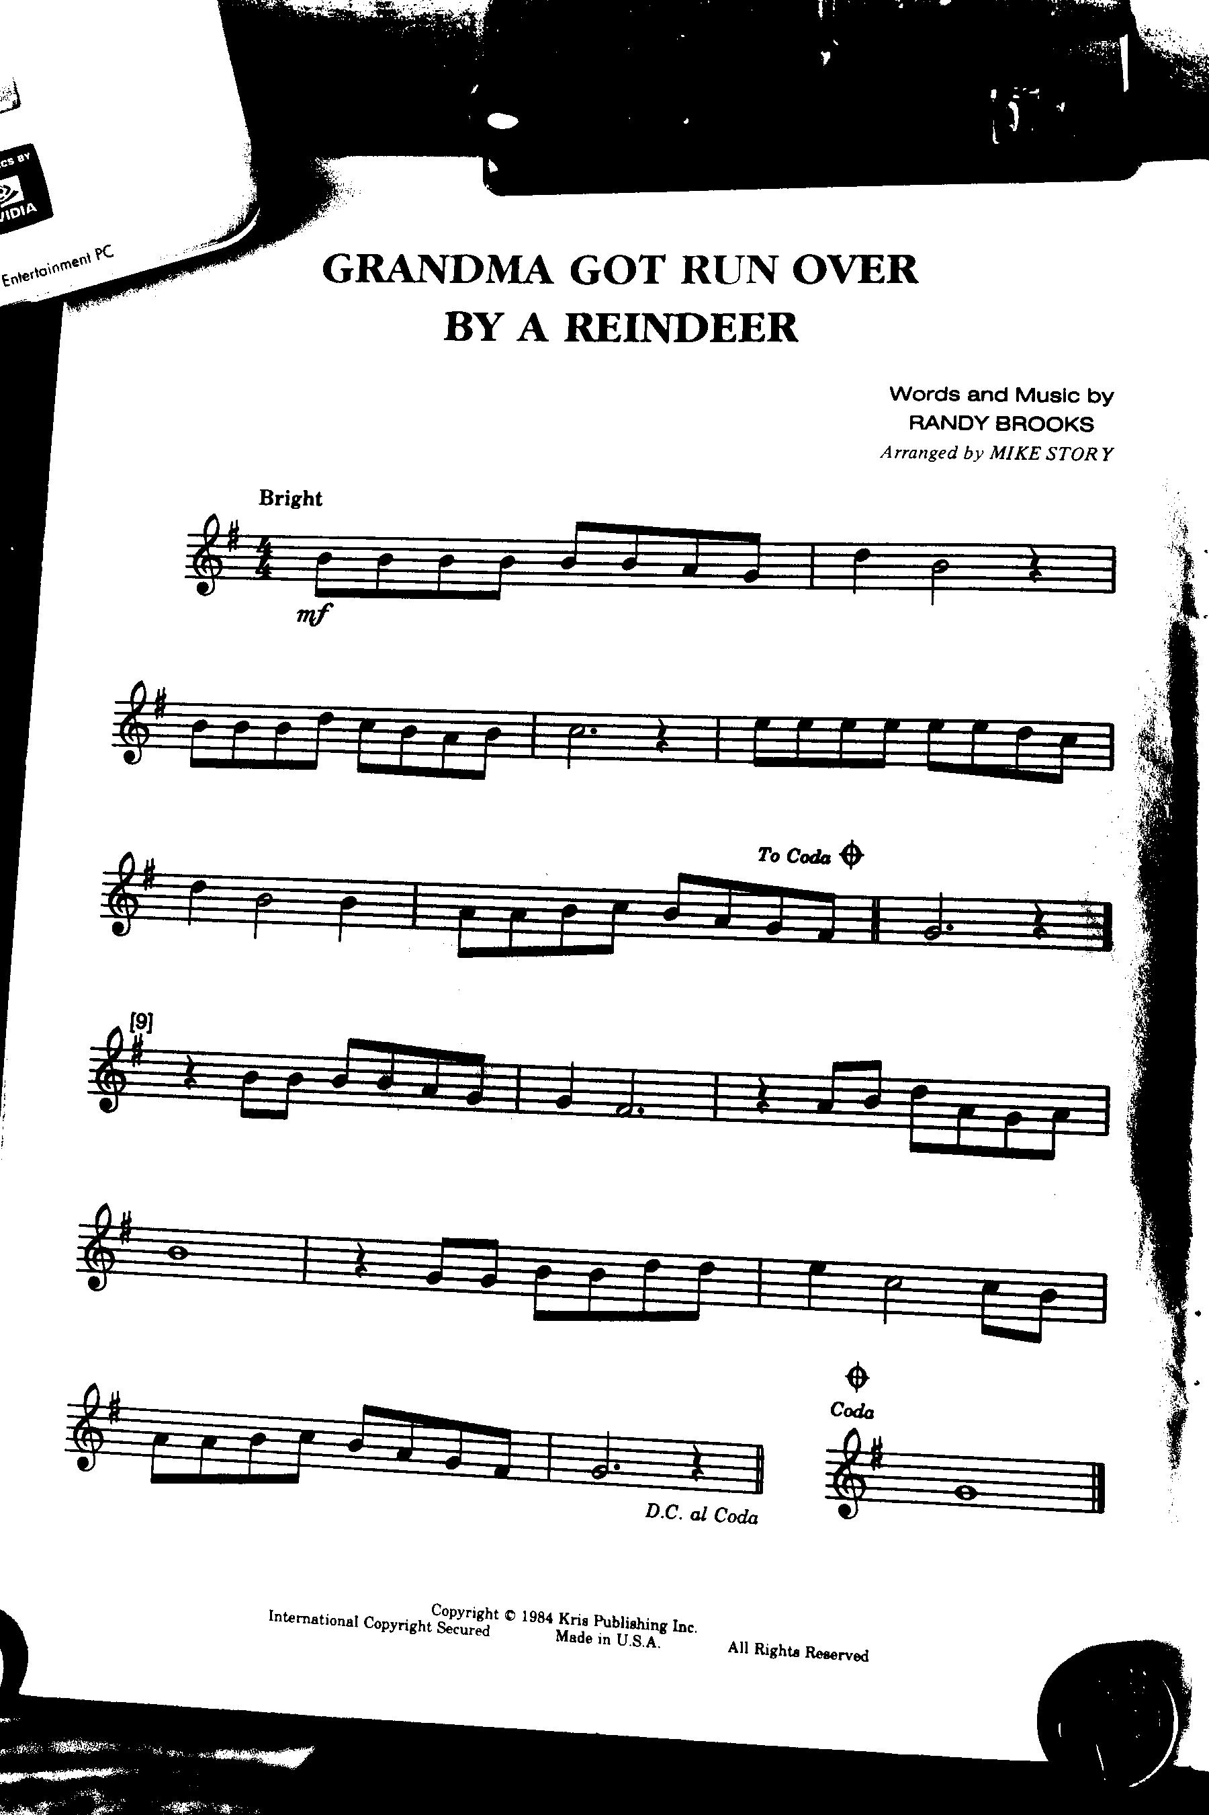
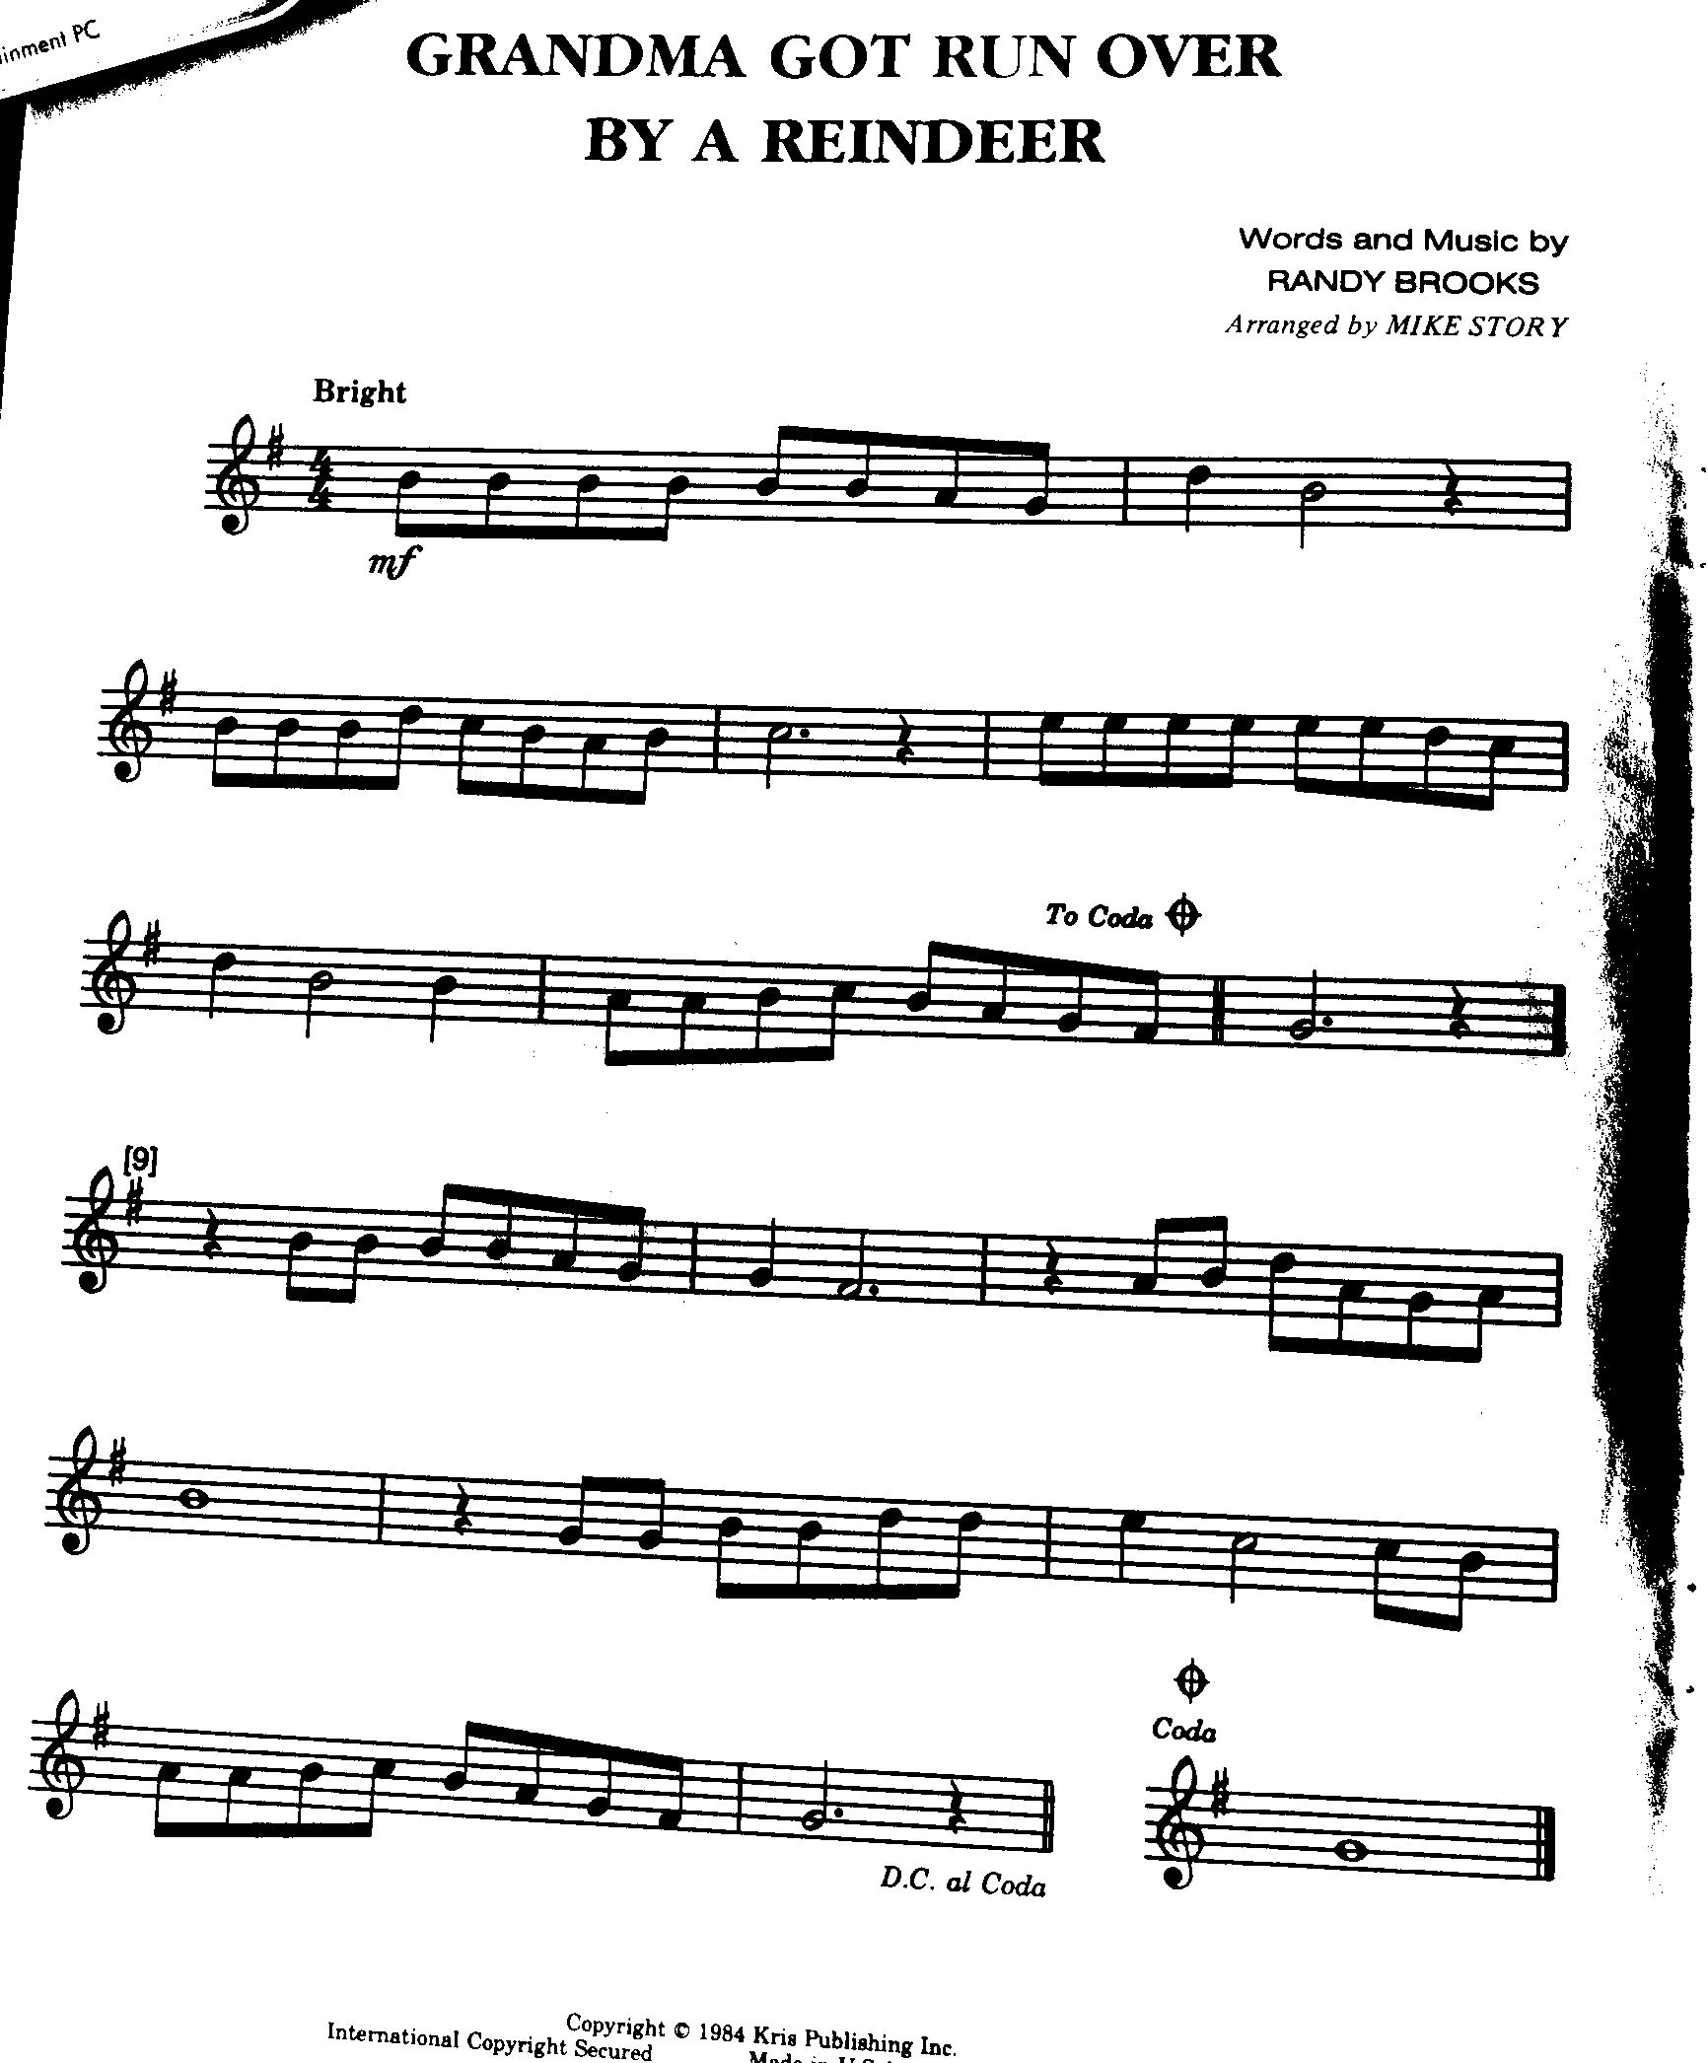
Preprocessing
Cropping
Original image
Cropped image
Notes:
TYLER

Slide 10
The Design
Preprocessing
Segmentation
Classification
Audio synthesis
Notes:
JOE

Slide 11
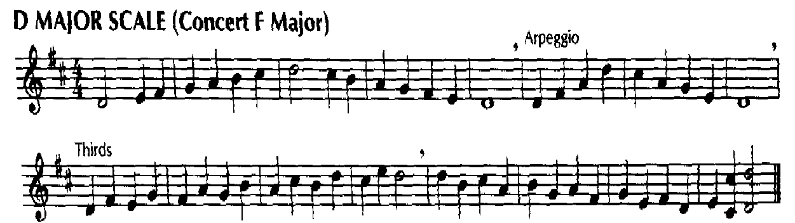
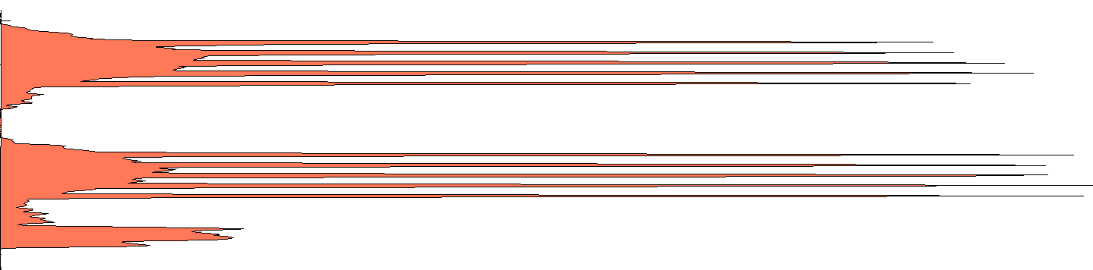
Segmentation
Staff detection
Original image
Y-projection
Notes:
JOE

Slide 12
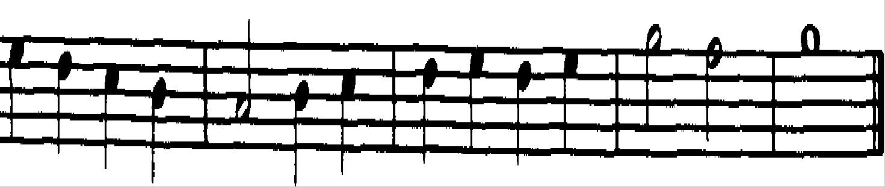
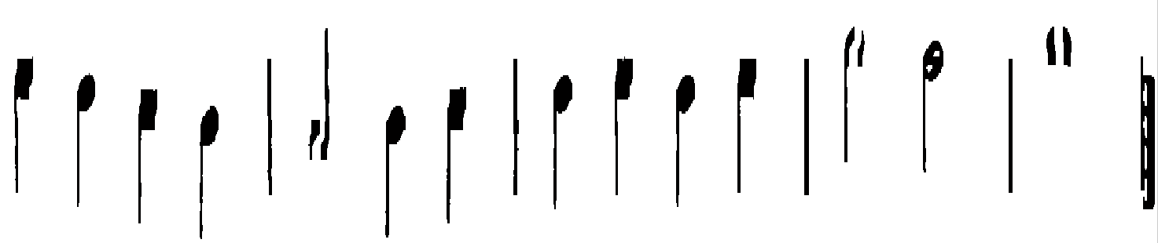
Segmentation
Line removal
Original image
Stafflines removed
Notes:
JOE

Slide 13
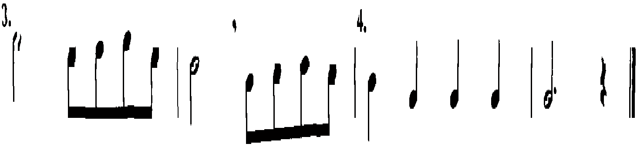
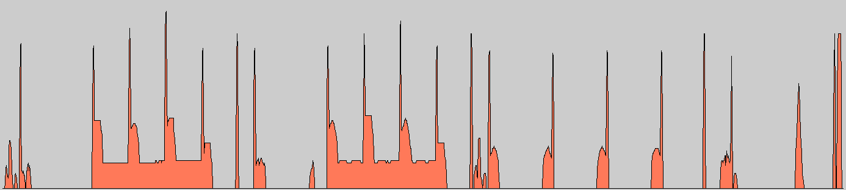
Segmentation
Stem & measure marker detection
Original image
X-projection
Notes:
JOE

Slide 14
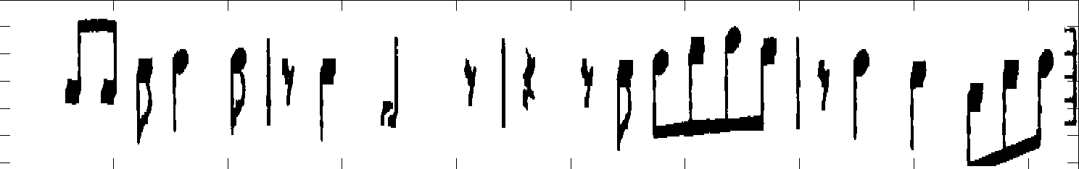

Segmentation
Remove stemmed notes from image
Find locations of remaining symbols
Original image
Notes removed, symbols located
Notes:
JOE

Slide 15
The Design
Preprocessing
Segmentation
Classification
Audio synthesis
Notes:
KATIE

Slide 16


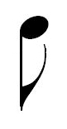
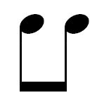
Classification
Stemmed notes
Pitch
Duration
Note-head type
Eighth-note tail
Notes:
KATIE

Slide 17

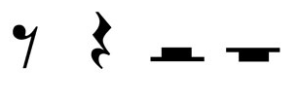


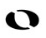



Classification
Remaining symbols
Whole notes
Rests
Accidentals
Dots
Classified via extracted features
Symbol dimensions
Proximity to other symbols
Presence of vertical lines
Black-to-white pixel ratio
accidental classification (based on vertical lines)
Notes:
KATIE

Slide 18
The Design
Preprocessing
Segmentation
Classification
Audio synthesis
Notes:
KATIE

Slide 19
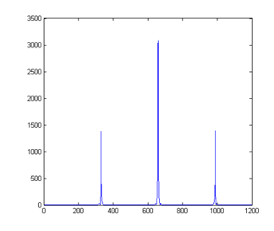
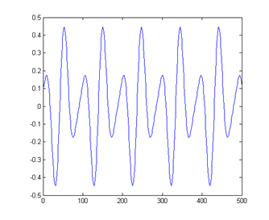
Audio Synthesis
Direct digital synthesis
Multiple FTV values for harmonics
Amplitude
Amplitude
Frequency (Hz)
Samples
FFT
Time signal
Notes:
KATIE

Slide 20
Hardware Implementation
Hardware
Altera DE2 FPGA with Nios II softcore processor
Altera D5M 5 Megapixel Camera
Hardware limitations
50 MHz clock
Memory space for only ~1.5 grayscale image copies
Lens distortion
Streamlined algorithms
Notes:
BRAD

Slide 21
Capabilities
Supported
Notes/rests up to eighth-beat speed
All key signatures
Accidentals
Dotted notes
Unsupported
Skew correction (in hardware)
Adaptive binarization (in hardware)
Chords
Ties/Slurs
Multiple melodies/harmonies
Repeat markers, DC al Coda, etc
Notes:
BRAD

Slide 22
EMO

Slide 23
Thank you for your time.
Can we entertain any questions?

